Slide 1


YouTube Songs Analysis
From T - Series Channel

Slide 2


Our Goal
The goal is to utilize Tableau to create insightful visualizations and reports that provide a deeper
understanding of YouTube songs' performance, popularity, and user engagement. The analysis aims to
uncover trends, preferences, and patterns in the data to aid content creators and stakeholders in
optimizing their YouTube song content.
Let’s start!

Slide 3
Dataset Details
The Dataset includes the following columns:-
Video id: Unique identifier for each YouTube video.
Channel Title: Title of the YouTube channel publishing the song.
Title: Title of the YouTube song video.
description: Description provided for the YouTube song video
Tags: Tags associated with the YouTube song video.
Published At: Date and time when the YouTube song video was published.
View Count: Number of views received by the YouTube song video.
Like Count: Number of likes received by the YouTube song video.
Favorite Count: Number of times the YouTube song video has been marked as a favorite.
Comment Count: Number of comments posted on the YouTube song video.
Duration: Duration of the YouTube song video in seconds.
Definition: Video definition or quality (e.g., HD, SD).
Caption: Availability of captions for the YouTube song video.
The Published at column was broken into Year , Month and Day columns for further analysis
Although there is the channel column , there is only one unique channel which is T-Series

Slide 4
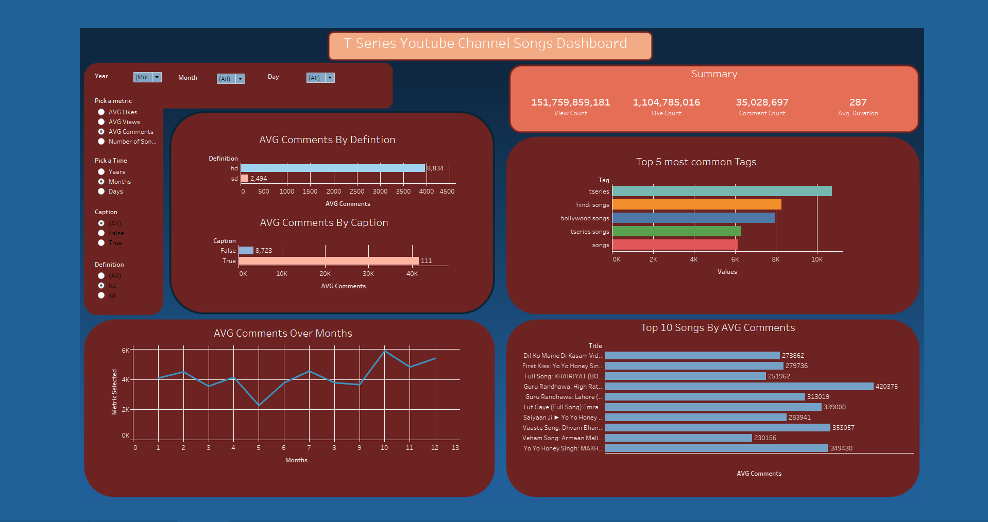

Slide 5

Insights Found
Likes, Comments and Views are all positively correlated.
The Year 2019 had the most interaction in terms of views and likes
with the top song being Vaaste song: Dhvani Bhanushali.
Interactivity is higher early in the year then fall down in middle but
becomes the highest later in the year and the highest was in
November.
Having captions had higher average likes, comments and views.
HD defintion had higher average likes, comments and views
The most common tags were tseries, hindi songs, bollywood songs,
tseries songs and songs.
Recomendations:-
Using HD defintion and having captions.
Releasing songs later in the year or early on.
Using popular tags.
Collaborating with popular artists.
Interact with viewers using comments.
Analyze metrics on a regular basis.

Slide 6



Thank you !

